Slide 1
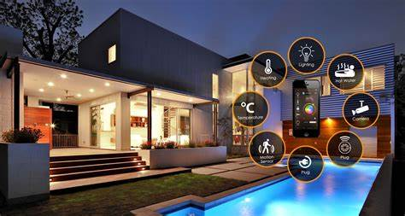
AMIT Graduation Project
Smart Home System
Members:
Abdelrahman Nasr Eldeen Aly.
Mohamed Mahmoud Onga.
Shehab Hesham Hussein.
Maryam Osama Abo Hashem.
Sara Mohamed Abdelftah.

Slide 2
Smart Home Features:
Controlling the AC system (DC Motor) using Timer_0 and ADC system
Enter password using keypad
Controlling the door using servo motor(PWM Motor) using timer_1
LCD interface to display user and admin prompts.
UART communication protocol to send functions’ status and receive commands from users.
Buzzer system to indicate intruder presence.
Password for users and admin saved in EEPROM.
5 LEDs and Dimmer LED (0%,25%,50%,75%,100%)

Slide 3
System Overveiw
The program starts by prompting the system's current state and for the users/admin to enter the password.
The users/admin can attempt 3 tries to enter the password after which the system is blocked with all features disabled.
The system could be reset using the reset button at any point during operation.
Once login is successful the AC system is enabled to monitor the temperature and control the DC motor accordingly.
Users/admin can enable several features (LEDs, Dimmer, Door [only admin]) by sending commands through UART.

Slide 4
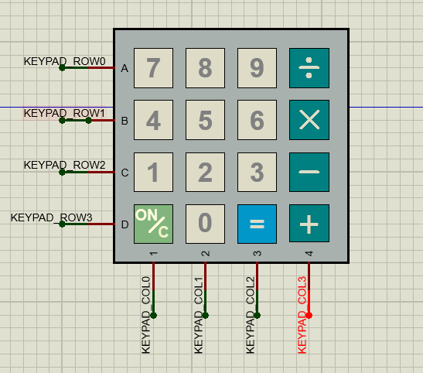
Keypad Interface:
Acts as input for the password.
The equal symbol is used as enter key.
Password is saved in the EEPROM

Slide 5
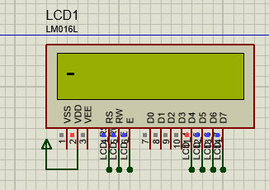
LCD Interface
Displays written password.
Displays the current operating feature.
Displays login status.

Slide 6
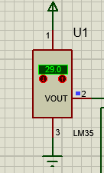
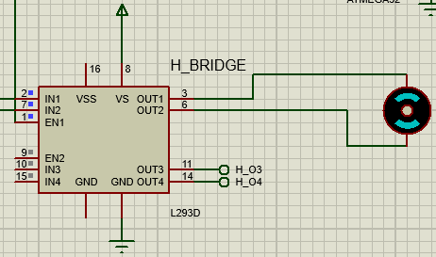
AC System
Control the motor using timer_0
ADC system indicates the temperature
If the temperature is greater than 28, the AC is turned on.

Slide 7
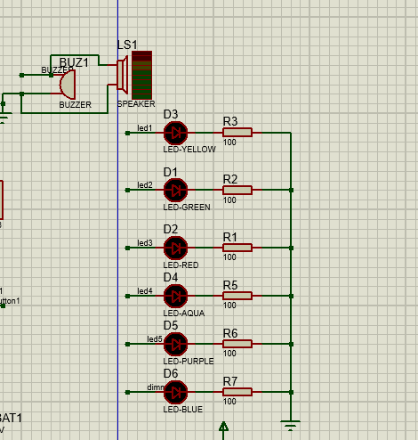
LED and Buzzer system
Buzzer works only when the system is Blocked.
LED system receives commands from either users/admin only when login is successful.
D6 is the dimmer led controlled by timer_2.

Slide 8
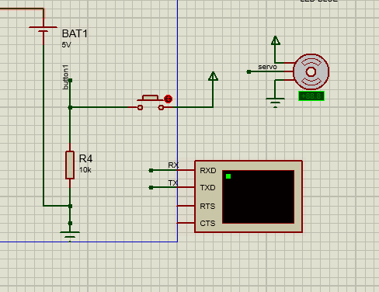
Reset button and Door control
The Servo motor (Door) is controlled via command sent by UART
The Servo motor is controlled using timer_1 to close or open the door
Interrupt will occur when the Reset button is clecked

Slide 9
UART
Used to send commands to operate features remotely.
Displays the features when turned on or off.

Slide 10
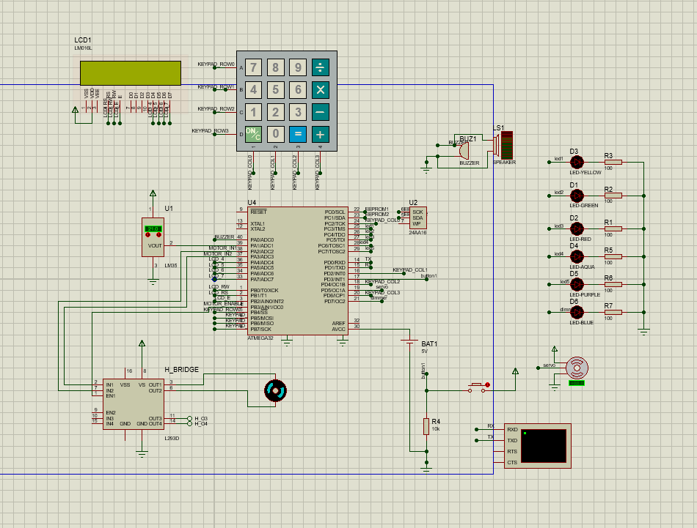
Complete simualation diagram

Slide 11


